Slide 1
Pulling Us Together Tearing Us Apart
An Nguyen
We’re all humans
…of New York

Slide 2
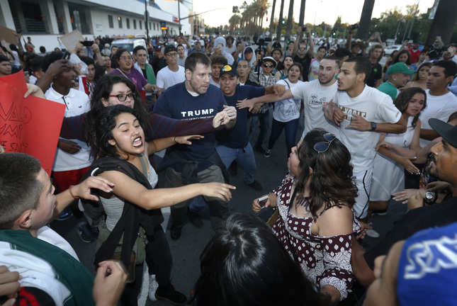

Humans both fight and care for one another
Notes:
War has been a part of human history for the past few thousand years
We’re social animals and yet we have walls and don’t always trust immediately
People want connections, and (care and feel cared for). Want to relate
I try to understand this problem better

Slide 3
Hypothesis
Abstract concepts (e.g. politics) invite analysis and division while personal details (e.g. my favorite uncle) arouse empathy and unification
Notes:
Mixing abstract and personal details will create a division level in between the abstract and personal division levels by themselves.
We can bring persuade people and have discourse without putting up walls

Slide 4
Method
Humans of New York Facebook page data pull
Topic modeling/clustering of posts and comments
Create targets that approximate discord
Create models to predict discord
Notes:
Topic modeling is grouping text data. These books are science. Those are fiction

Slide 5
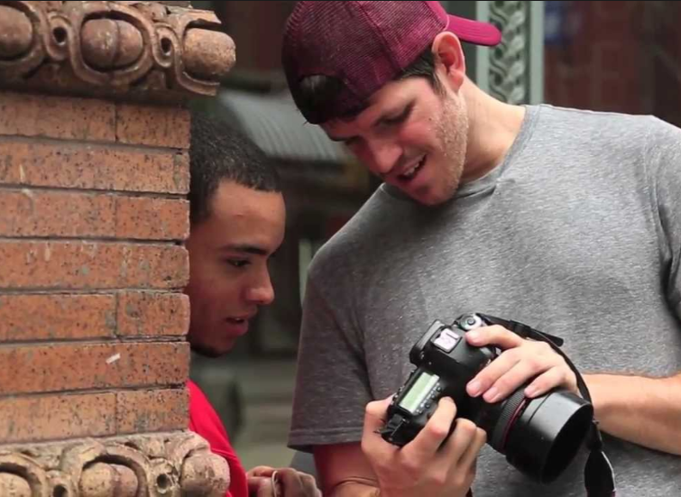
Humans of New York
A photography blog created by Brandon Stanton that includes personal stories and quotes
Blog has over 20 million followers
Public Facebook and Instagram pages
Stories from over twenty different countries

Slide 6

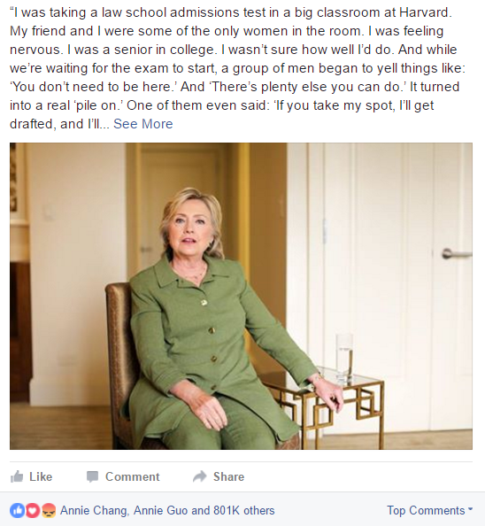
HoNY has a wide range of people and topics
Notes:
While many comment are encouraging, there have been disagreements as the blog has grown

Slide 7

Humans of New York on Facebook
Facebook Graph API
~6.5 thousand posts
~36 million comments
Only pulled ~4 million comments corresponding to 390 posts
Various reactions available

Slide 8
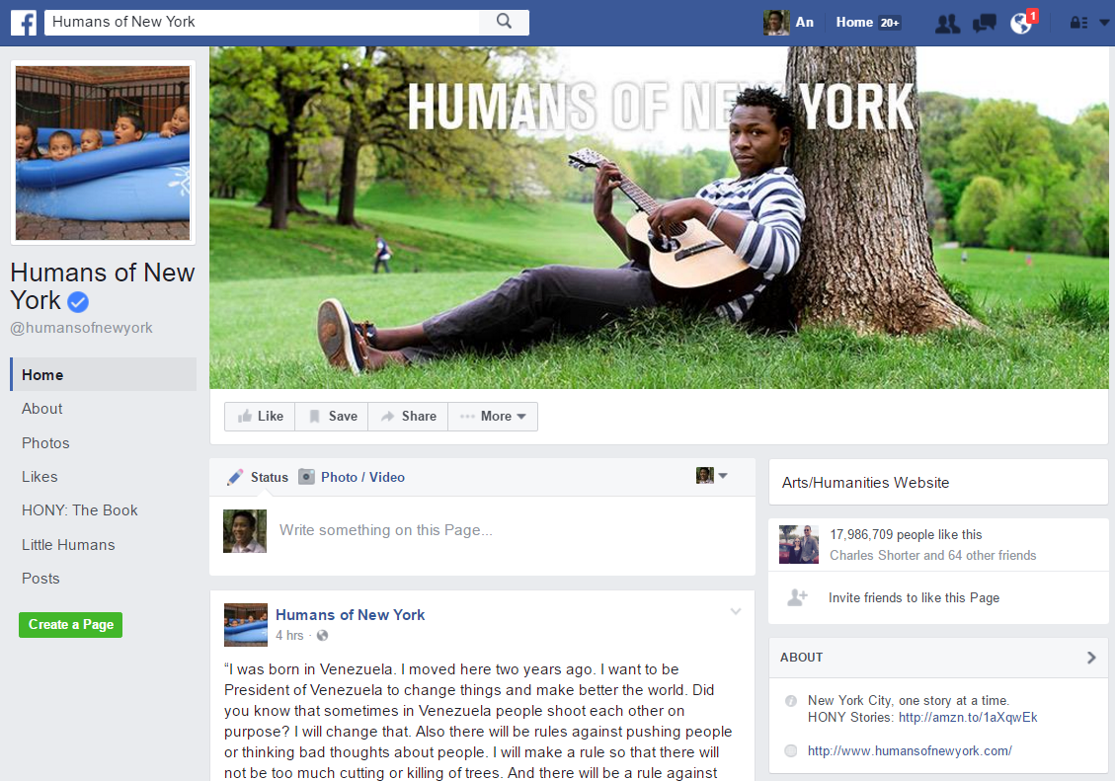

Slide 9
Latent Dirichlet Allocation (LDA) used to create clusters/topics
Assumes documents are made up of different topics
Topics are a “bag of words”
Steps
You tell the algorithm how many topics you think there are
The algorithm will assign every word to a temporary topic using the Dirichlet distribution
The algorithm will check and update topic assignments (Iterative)
How prevalent is that word across topics?
How prevalent are topics in the document?
Notes:
Create unigrams, bigrams, and trigrams

Slide 10
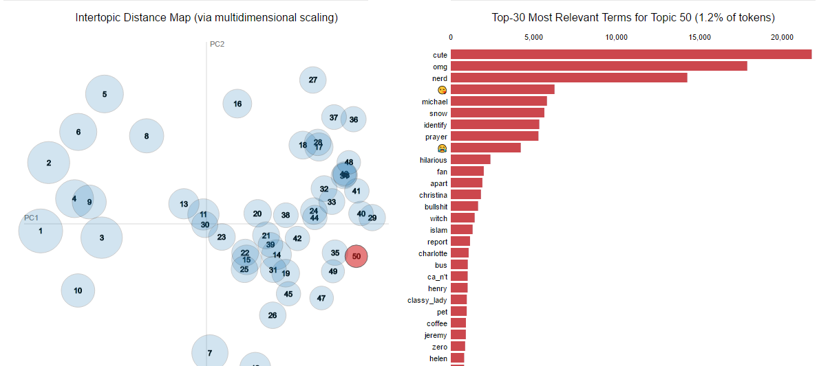
Topic Modeling with Stories and Comments
Tried different number of topics (5, 15, 50)
Discovered setting alpha to .3 gave a good balance between document specificity and relevance
Notes:
Unsuperivised learning. Choose how many topics. Posts were not as helpful as seen here in coming up with topics.
Used AWS
Walk through LDA.
Tried different number of topics (5, 15, 50)
Tried different Ks. Also set alpha to .3 is a good mix of words pertinent to the document and overall. Too left, you get names. Too right, you get think, get etc.
Favorite topic was “Manager, employee, enemy, asshole”

Slide 11
Topics | Bag of Words
School | student, learn, year, school , father, daughter, husband, age, college, young, chance, lesson, high school, skill, special education teacher, program achieve, degree, education, educator, career, key, complete, graduate, teach, opportunity
Close Relationships | kid, child, teacher, parent, dad, military, raise, wife
Work | Work, hard, employee, manager
Religion | God, church, bible, right, hope, soul, grace, union, bless, jesus, religion
Money | Poor, pay, rich, price
Health | Doctor, health, mental, illness, tumor, nurse, surgery, cancer, medication, disease
Change | Need, world, help, change, fight, core, ability, grow, better, accomplish, succeed, travel, accept, seek, desire, forgiveness, fate, care
Political | People, war, kill, bad, America, issue, blame, action, fact, government, hurt, fix, victim, murder, treat, innocent, poverty, trouble, politician, tired, trauma

Slide 12
Targets and Models
Targets
Models
Percent of replies per post
Replies may be indicative of arguments
Percent of Conversations with >20 replies
Sentiment median by post
Sentiment standard deviation by post
Linear Regression
Bayesian Ridge Regressor
Random Forest Regressor
AdaBoost Regressor
Gradient Boosting Regressor
Bagging Regressor
K Neighbors Regressor
Notes:
Played with 10, 20 and 30 replies. Seem the same.

Slide 13
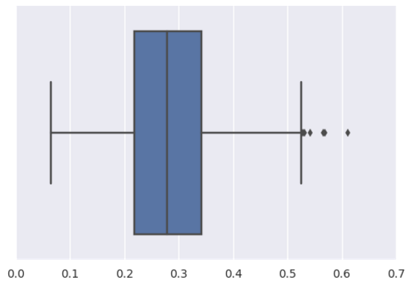
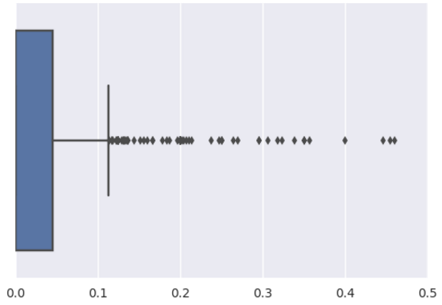
Not All Target Distributions Similar
% Replies per Post
Sentiment Median
Notes:
Dissimilar distribution key to different scores for models

Slide 14
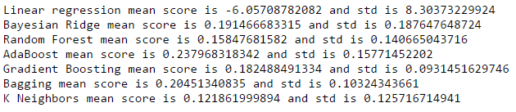
AdaBoost had the best R^2 The target is % of conversations >20 replies
Notes:
Tried other targets: difference in median sentiment, difference in std sentiment.

Slide 15
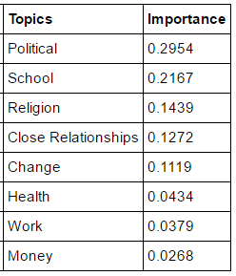
The “Political” topic had the highest feature importance

Slide 16
Improvements
Pull more comment data
Try a categorical target based on the tail ends of the sentiment distribution
Include a data source known to include debate on clear topics (e.g. newspaper comments, certain Reddit threads, political blogs)

